Slide 1

Chörbli
Team DangerRanger

Slide 2

Das Problem

Slide 3

1
5
27
69
+99

Slide 4


Slide 5
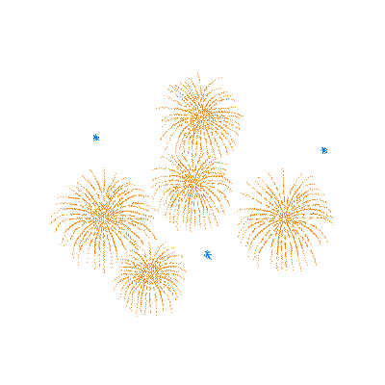
Gameification

Slide 6
Demo

Slide 7


Slide 8


